Slide 1
Web API Design
Jeremy Likness | Principal Architect
Christopher Harrison | Content Developer

Slide 2

Meet Jeremy Likness | ‏@jeremylikness
Principal Architect at iVision
Focused on Microsoft stack Enterprise Applications
http://csharperimage.jeremylikness.com/
Former Certified Fitness Trainer and Specialist in Performance Nutrition
Over 20 Years of Professional Experience
4-time Author incl. Programming the Windows Runtime by Example
Prolific speaker at conferences including DevLink, CodeStock, and the Microsoft Worldwide Partner Conference
5 Year Microsoft Most Valuable Professional (MVP)
9-Ball player

Slide 3

Meet Christopher Harrison | @geektrainer
Principal Program Manager, Microsoft
Web developer focused on Windows Azure and ASP.NET
Blogging at http://hanselman.com for over a decade
One of Microsoft’s Most Respected Developers
Written a number of books and spoken in person to almost a half million developers worldwide
http://hanselminutes.com for tech talk
http://thisdeveloperslife.com on developers’ lives and loves
http://ratchetandthegeek.com for pop culture and tech media

Slide 4
Course Topics
Web API Design
01 | Introduction to Web API | 04 | Validation and Error Handling
02 | Basic Web API Design | 05 | Security
03 | Configuration | 06 | Advanced Web API Design

Slide 5
Setting Expectations
Please leave this area blank to allow for picture in picture recording
Target Audience
Web Application Developer
Interesting in building public-facing RESTful APIs
Would like to expand knowledge of Web API design
Suggested Prerequisites/Supporting Material
Visual Studio 2013+

Slide 6
Join the MVA Community!
Please leave this area blank to allow for picture in picture recording
Microsoft Virtual Academy
Free online learning tailored for IT Pros and Developers
Over 1M registered users
Up-to-date, relevant training on variety of Microsoft products
“Earn while you learn!”
Get 50 MVA Points for this event!
Visit http://aka.ms/MVA-Voucher
Enter this code: PowerJump1 (expires 8/15/2013)

Slide 7
Please make sure there’s a “Module Transition” slide for every module
01 | Introduction to Web API
Jeremy Likness | Principal Architect
Christopher Harrison | Content Developer

Slide 8
Module Overview
Please leave this area blank to allow for picture in picture recording
ASP.NET Web API
Web API Design
REST
HATEOAS
Scaffolding

Slide 9
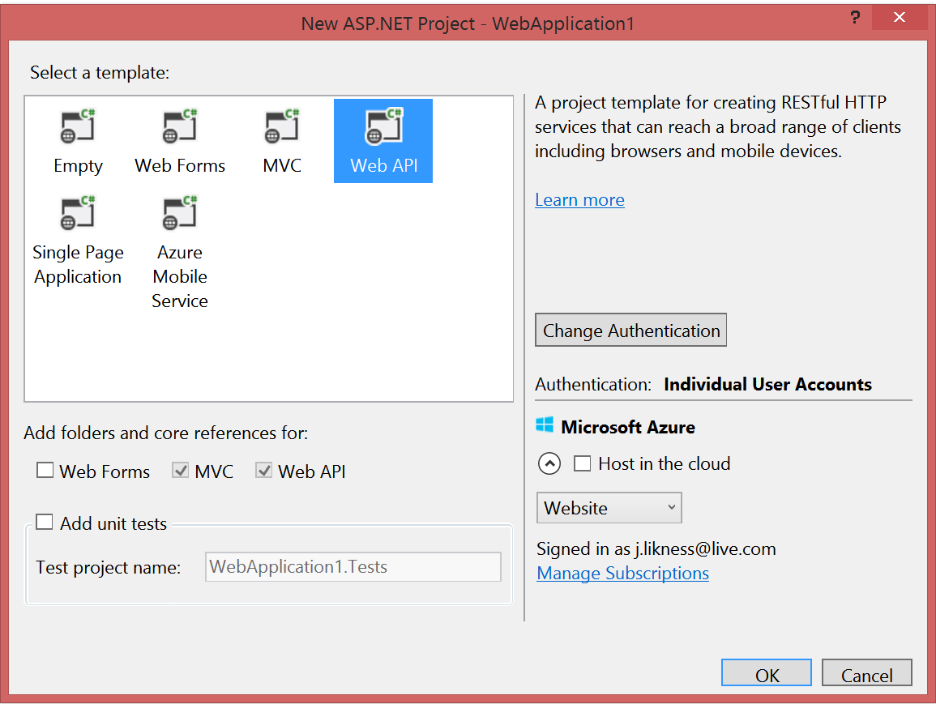
ASP.NET Web API
Please leave this area blank to allow for picture in picture recording
Option for web applications
Makes it easy to build HTTP-based services
Ideal for RESTful APIs

Slide 10
But what is Web API design?
Please leave this area blank to allow for picture in picture recording
An intentional approach to building APIs
A “must have” if your APIs will be consumed by third-party services
Attention to details:
How consumable is the API (signature, content negotiation)?
Does it comply with standards (response codes, etc.)?
Is it secure?
How do you handle multiple versions?
Is it truly RESTful?

Slide 11
Representational State Transfer (REST)
Please leave this area blank to allow for picture in picture recording
Client-server
Stateless
Resource-based (vs. remote procedure call)
HTTP methods (GET, POST, PUT, DELETE)
Indempotency and side effects
It’s a style, not a standard
Don’t hate on HATEOAS

Slide 12
Hypermedia as the Engine of Application State (HATEOAS)
Please leave this area blank to allow for picture in picture recording
Hypermedia is the key
It all starts at a URL
Resources are returned
Media types and locations are included
References based on state

Slide 13
REST and HATEOAS in Action
Please leave this area blank to allow for picture in picture recording
Notes:
http://odata.org examples

Slide 14
Scaffolding
Please leave this area blank to allow for picture in picture recording

